Slide 1
Chemistry and the Environment
Polluting the Atmosphere

Slide 2
Key Points
Human activities are causing global warming.
Combustion of fuel produces many pollutants.
Humans can reduce their impact on the environment.

Slide 3
The greenhouse effect
Without greenhouse gases in its atmosphere, the Earth would be about 18°C colder on average than it is now. That would make it too cold to support life as we know it.
Greenhouse gases present in the atmosphere include:
water vapour
carbon dioxide
methane
These greenhouse gases:
absorb heat radiated from the Earth
then release energy in all directions, which keeps the Earth warm

Slide 4
The diagram gives more details about this process, called the greenhouse effect

Slide 5
How the greenhouse effect works
Electromagnetic radiation at most wavelengths passes through the Earth's atmosphere.
The Earth absorbs most of the radiation and warms up.
The Earth radiates energy as infrared radiation.
Some of the infrared radiation goes into space.
Some of the infrared radiation is absorbed by greenhouse gases in the atmosphere.
The lower atmosphere warms up.

Slide 6
Human activities and the greenhouse effect
Human activities are increasing the amount of some greenhouse gases in the atmosphere. For example:
farming cattle releases methane
farming rice in paddy fields releases methane
burning fossil fuels in vehicles and power stations releases carbon dioxide
deforestation releases carbon dioxide and reduces the absorption of carbon dioxide through photosynthesis

Slide 7
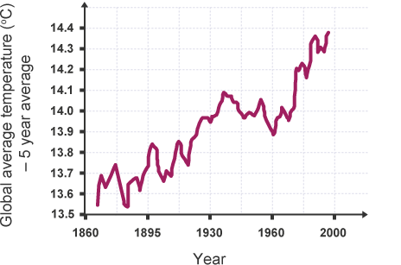
Global Warming
Global warming is not the same as climate change. Global warming is usually used to describe the warming of the climate in the past 200 years, which the vast majority of scientists are almost certain has been caused by human activities.
The graph shows how the Earth’s average temperature has gradually increased over time

Slide 8
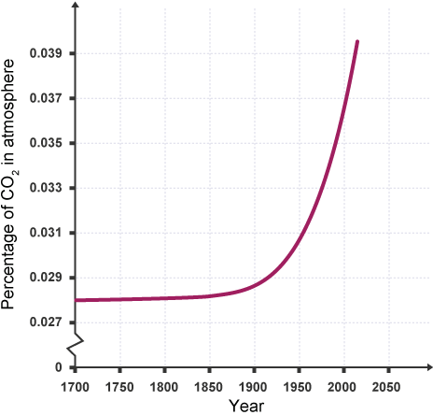
The correlation between carbon dioxide and global warming
One of the commonly used pieces of evidence that humans are causing global warming is that there is a strong correlation between the increase in global carbon dioxide levels caused by human activities and the increase in global temperatures over the same timescale.
Compare this graph to the previous one above

Slide 9
The effects of global warming
The effects of global warming include:
glaciers and polar ice melting
sea levels rising
patterns of rainfall changing, producing floods or droughts
habitats changing
We are already experiencing some of these effects. The consequences of global warming will affect billions of people, all around the world.

Slide 10
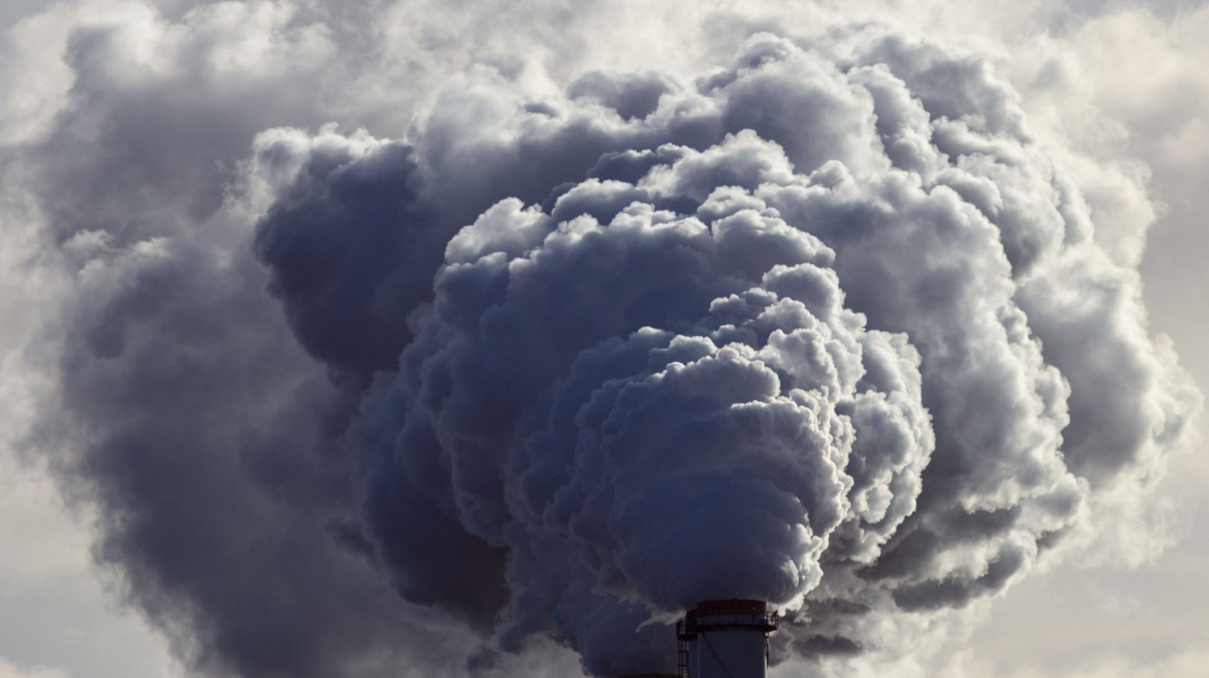
The Carbon Footprint and its Reduction
The carbon footprint of a product is the total amount of carbon dioxide (and other greenhouse gases) which are emitted over the full life cycle of a product, service or event.
For example, the carbon footprint of a car would include the carbon dioxide emitted by:
machinery whilst the metal is extracted from the Earth's crust and processed
power stations which generate the electricity used to manufacture the car
the car itself when it is driven for many years
the machinery which is used to dispose of or recycle the car

Slide 11
The carbon footprint of a person during one year would consist of the total amount of carbon dioxide released into the atmosphere by all of the activities they take part in, and the manufacture, use and disposal of all the products and resources they use.
For example, a typical young person might:
use electricity at home, probably generated from fossil fuels, for lighting their room and using electronic devices
use a gas-powered boiler at home (which produces carbon dioxide) for heating and hot water
travel to school by bus or car (which probably runs on petrol or diesel)
eat beef or rice which have been farmed using methods that release methane
travel abroad once per year on an aeroplane (which produces carbon dioxide)

Slide 12
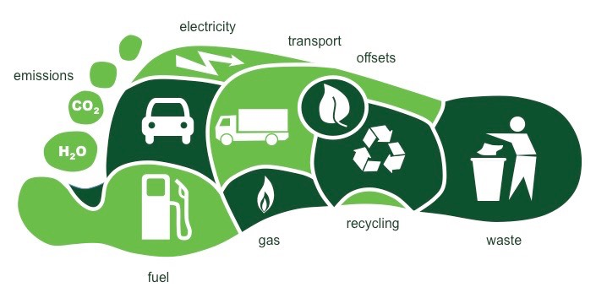

Slide 13
Combustion of hydrocarbon fuels
Most fuels contain carbon and/or hydrogen. When hydrogen atoms are present in a fuel, they are oxidised to water. Water is not a pollutant.
When there are lots of oxygen atoms present during combustion, the carbon atoms are completely oxidised to carbon dioxide. When there are fewer oxygen atoms present, carbon monoxide or carbon may be produced during combustion.

Slide 14
Combustion
Complete combustion of a hydrocarbon fuel occurs when there is a good supply of oxygen.
It releases the maximum amount of energy and produces carbon dioxide and water.
Incomplete combustion of a hydrocarbon fuel occurs when there is a poor supply of oxygen.
Less energy is released.
Water is still produced from the hydrogen atoms.
Instead of carbon dioxide, you might get carbon monoxide or particulate carbon, known commonly as soot, or a mixture of both.

Slide 15
Problems with incomplete combustion:
Carbon monoxide is a poisonous gas which binds to haemoglobin in your red blood cells, preventing them from carrying oxygen to the cells in your body. Carbon monoxide is colourless and has no smell, so it is very difficult to tell if you are breathing it in. It can be detected by electronic detectors which are often fitted near to boilers.
Particulate carbon can cause health problems for humans because it irritates the lining of the lungs, can make asthma worse, and perhaps even cause cancer. Particulate carbon can also cause global dimming, which may reduce rainfall.

Slide 16
Atmospheric pollutants
When fuels are burned, a number of atmospheric pollutants are produced.
Here are some of the pollutants from burning fuels, and where they come from:
Pollutant | Source
Carbon dioxide, CO₂ | Complete combustion of any fuel containing carbon atoms
Carbon monoxide, CO | Incomplete combustion of any fuel containing carbon atoms
Particulate carbon, C (soot) | Incomplete combustion of any fuel containing carbon atoms
Unburned hydrocarbons | Hydrocarbon fuel molecules which have not been oxidised at all
Sulfur dioxide, SO₂ | Combustion of a fossil fuel which contains sulfur impurities
Nitrogen oxides, NO_{x} | Oxidation of atmospheric nitrogen inside the engine of a car, lorry, etc

Slide 17
Sulfur dioxide and Acid Rain
Sulfur dioxide is caused when sulfur atoms which are present in some fossil fuels are oxidised:
sulfur + oxygen → sulfur dioxide
S + O₂ → SO₂
Sulfur dioxide is then further oxidised in the atmosphere to sulfur trioxide, SO₃. This gas dissolves in rainwater to make acid rain, which is a dilute solution of sulfuric acid, H₂SO₄.
The two reactions are:
sulfur dioxide + oxygen → sulfur trioxide
2SO₂ + O₂ → 2SO₃
And then:
sulfur trioxide + water → sulfuric acid
SO₃ + H₂O → H₂SO₄
Acid rain harms and kills plants and animals, especially those that live in aquatic environments.
It can also damage man-made objects like statues and buildings.

Slide 18
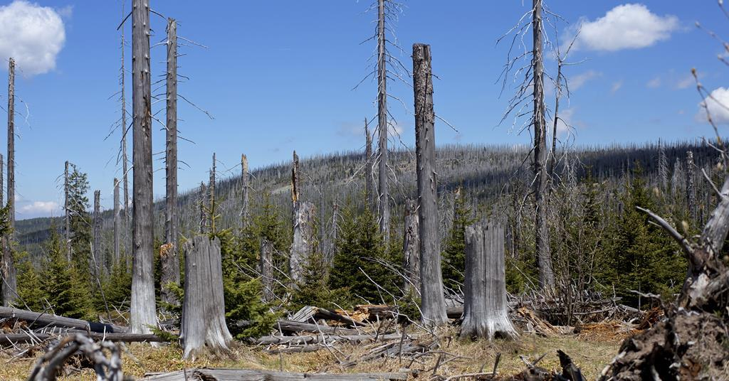

Slide 19
NO_{x} gases as pollutants
Nitrogen is not present in fuels, but the high temperatures and pressures inside a car engine can cause the nitrogen and oxygen in the air to react together to make oxides of nitrogen.
There are several compounds formed when nitrogen bonds with oxygen, but the two which are made inside engines are NO and NO₂. These two pollutants are grouped together with the general formula NO_{x}.
NO_{x} gases can cause acid rain, and they also react in the atmosphere with other pollutants to make photochemical smog.
Smog can have major health effects, causing asthma attacks and even death.

Slide 20
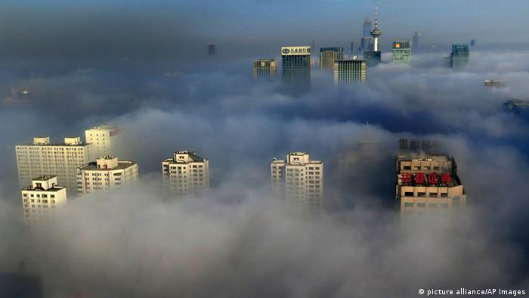

Slide 21
Contamination and Purification of Water
Water is essential for life.
Water that is safe for humans to drink is called potable water.
Potable water is not pure water because it almost always contains dissolved impurities.
For water to be potable, it must have sufficiently low levels of dissolved salts and microbes.
This is because:
dissolved salts can sometimes be harmful for humans
microbes can cause illnesses

Slide 22
Waste Water Treatment
Waste water from homes, industry and agriculture must be treated before being released into the environment.
Here are some examples of pollutants which might be present in waste water:
human waste contains harmful bacteria and high levels of nitrogen compounds which can harm aquatic ecosystems
industrial waste water may contain harmful chemicals such as toxic metal compounds
agricultural waste water may contain fertilisers or pesticides which can disrupt sensitive ecosystems

Slide 23
Sewage treatment involves the following steps:
screening and grit removal to remove large particles
sedimentation allows tiny particles to settle out from still water, which produces sewage sludge and effluent (the liquid which remains on top)
the sewage sludge is digested anaerobically by specific bacteria
the effluent is treated with aerobic bacteria to reduce the volume of solid waste

