Slide 1
The New Art of The Bourgeoisie
4 eso
Romanticism, Realism, Impressionism, Modernism

Slide 2
Artistic Styles
Realism
Post-Impressionism
Romanticism
Impressionism
Modernism
Second half of 19th century
mid-1880s
First Decades of 19th century
Last third of 19th century
Late 19th century

Slide 3
Romanticism
Paintings celebrated a love of freedom and the glorification of the individual
Promoted emotion over rationalism of the Enlightenment
Used curved and diagonal lines to create movement in paintings
Used bright colors and loose brushstrokes in paintings

Slide 4
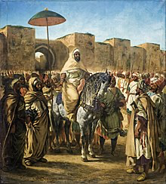
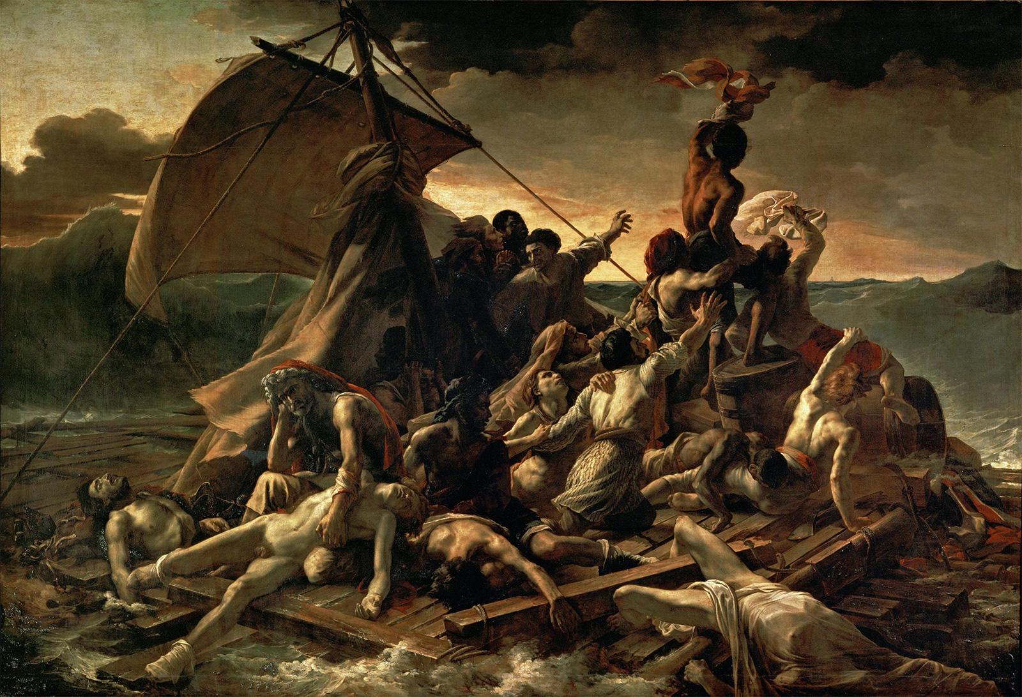
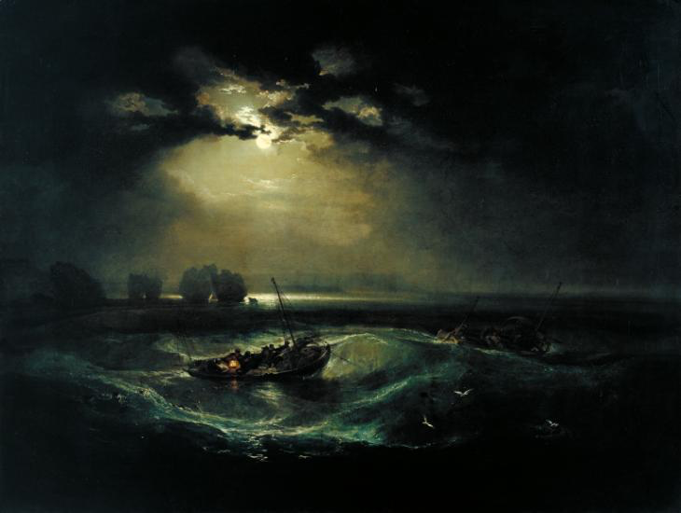
Romanticism Artists
Eugene Delacroix
Theodore Gericault
Joseph W. Turner

Slide 5
Realism
Paintings showed the social problems in society at the time
Focused on social inequalities
Examined the spread of industrialisation, poverty, and child labour
Advances in science made people think observing and describing were the only ways to understand reality

Slide 6
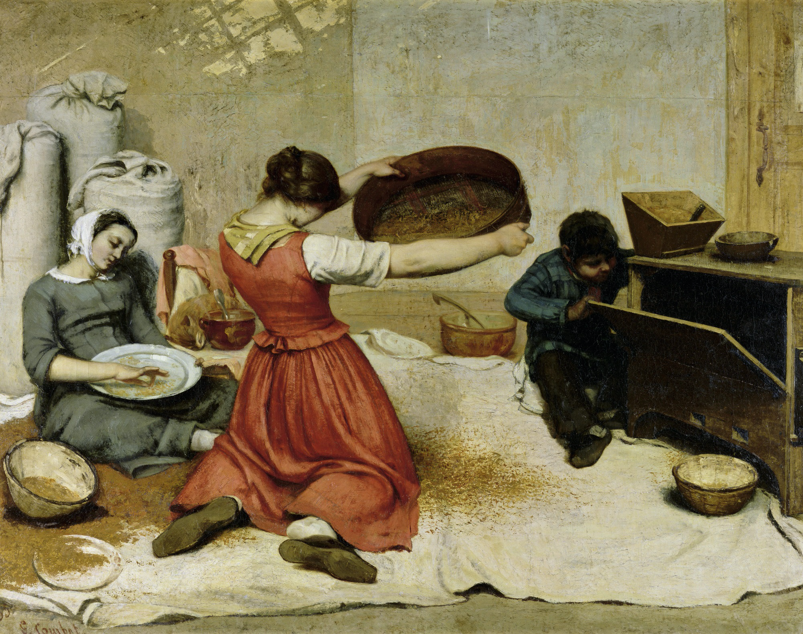
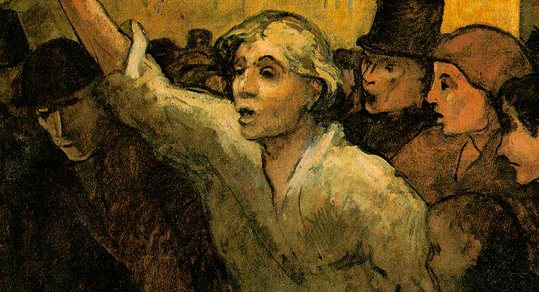
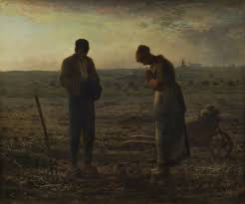
Realism Artists
Gustave Courbet
Honore Daumier
Jean Francois Millet

Slide 7
Impressionism
Goal was to depict the changing effect of light on objects
More interested in the color of paintings than the form
These painters preferred to paint outside
Painters used rapid, loose brushstrokes in the paintings
Goal was to paint how a painter saw things and not what the painters saw.

Slide 8
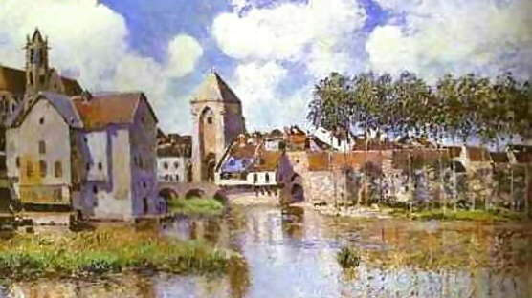
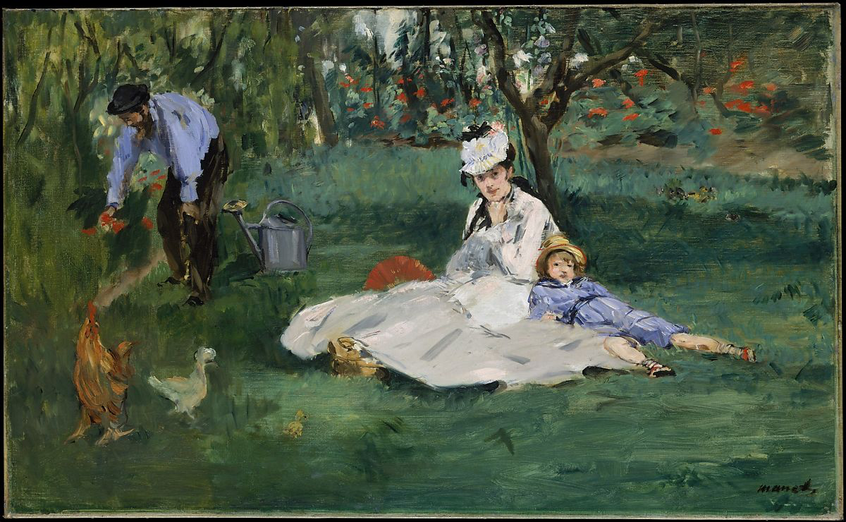
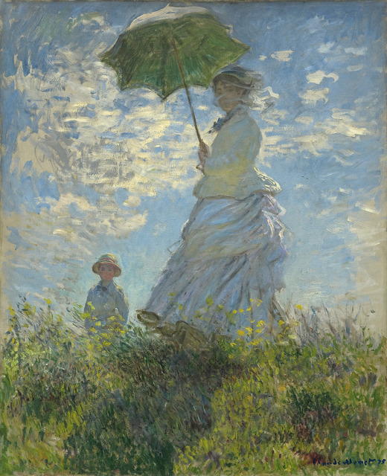
Impressionism Artists
Edouard Manet
Alfred Sisley
Claude Monet

Slide 9
Post-Impressionism
Explored areas such as geometry
Focused on lines and expressiveness
Also focused on the color used in paintings

Slide 10
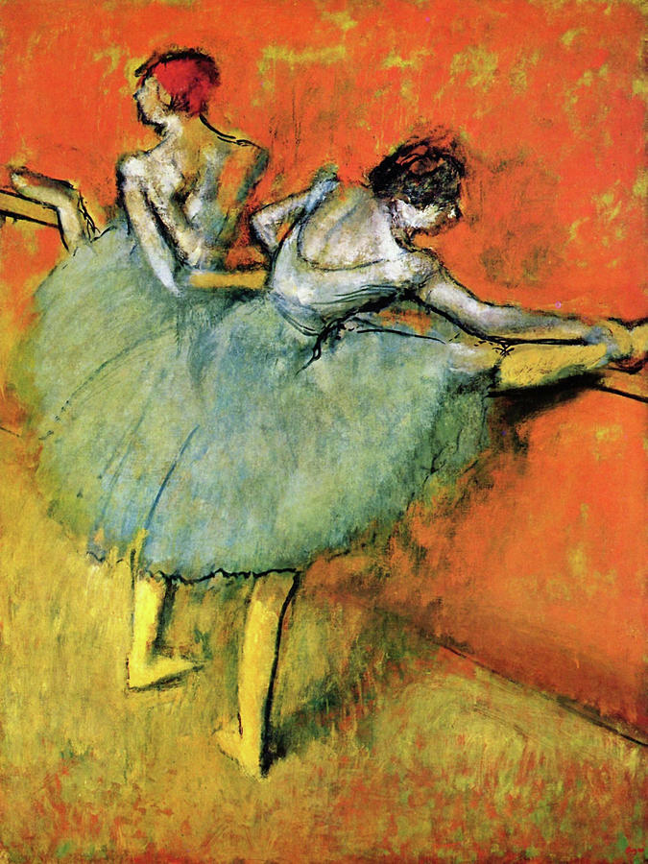
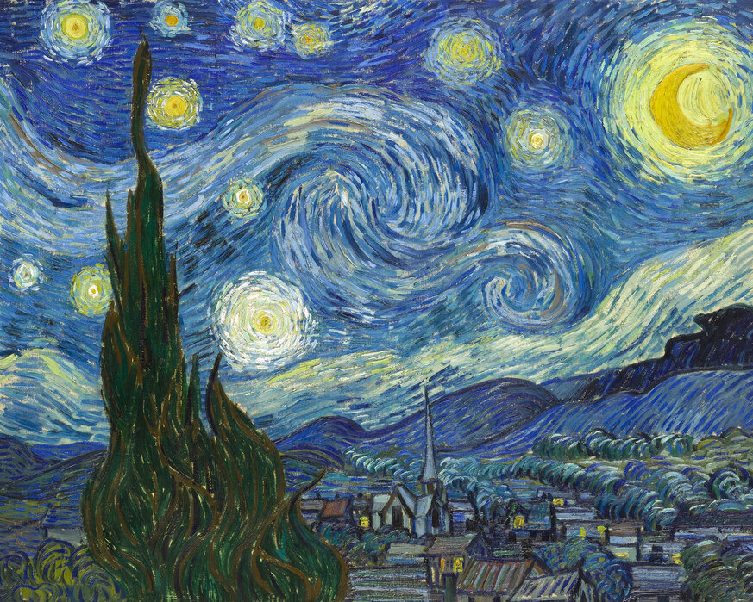
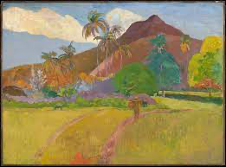
Post-Impressionism Artists
Paul Gauguin
Vincent Van Gogh
Edgar Degas

Slide 11
Modernism
Was mostly an Architectural movement
Focused on symbols and conceptual themes rather than subjects
Recurring theme was women
Movement was inspired by nature and often included shapes rather than objects

Slide 12
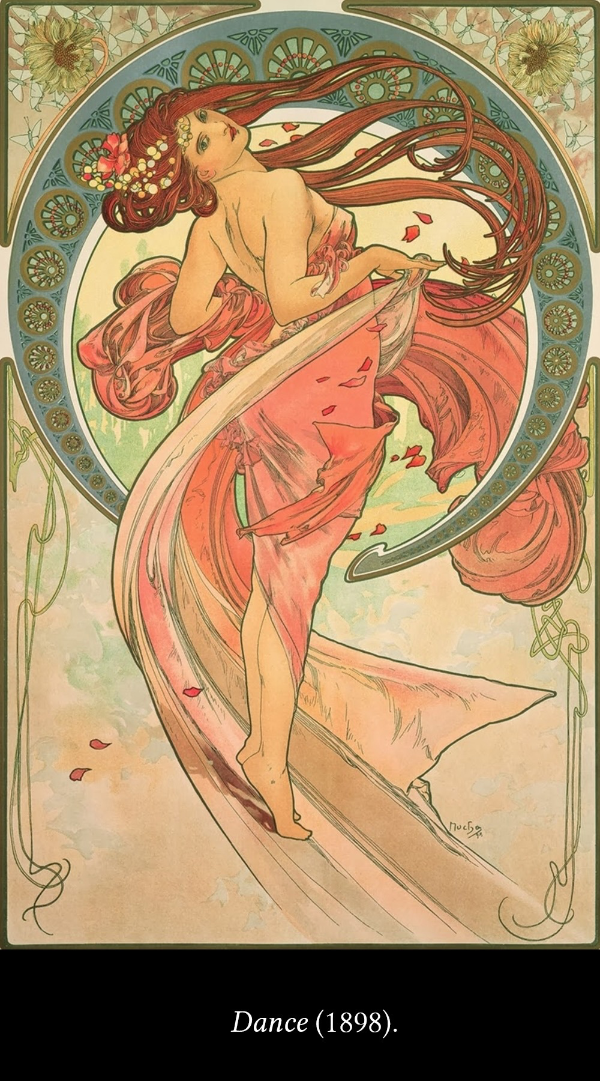
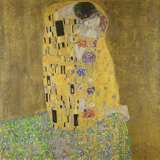
Modernism Artists
Gustav Klimt
Alphonse Much

Slide 13
Matching
Focused on the changing light of objects and color in paintings
Showed freedom and glorification in paintings
Painted symbols and themes instead of objects
Painted reality and focused on social problems
Focused on geometry and expressiveness
Romanticism
Realism
Impressionism
Post-Impressionism
Modernism

Slide 14
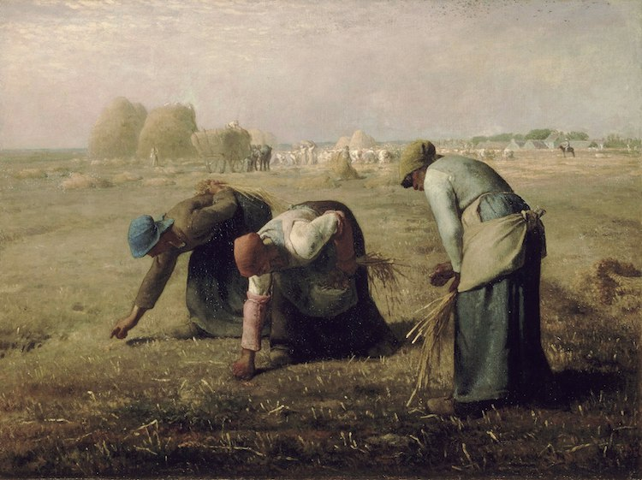
What artistic style is this?
Romanticism
Realism
Impressionism
Post-Impressionism
Modernism

Slide 15
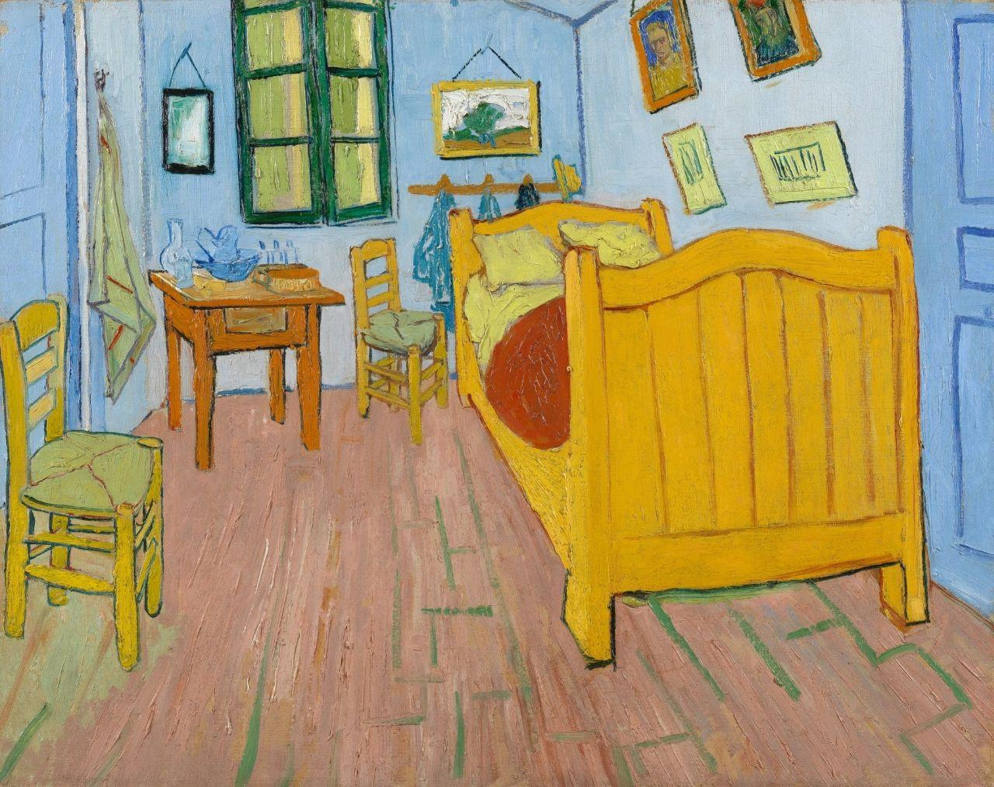
What artistic style is this?
Romanticism
Realism
Impressionism
Post-Impressionism
Modernism

Slide 16
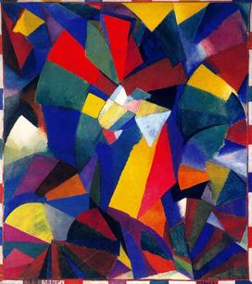
What artistic style is this?
Romanticism
Realism
Impressionism
Post-Impressionism
Modernism

Slide 17
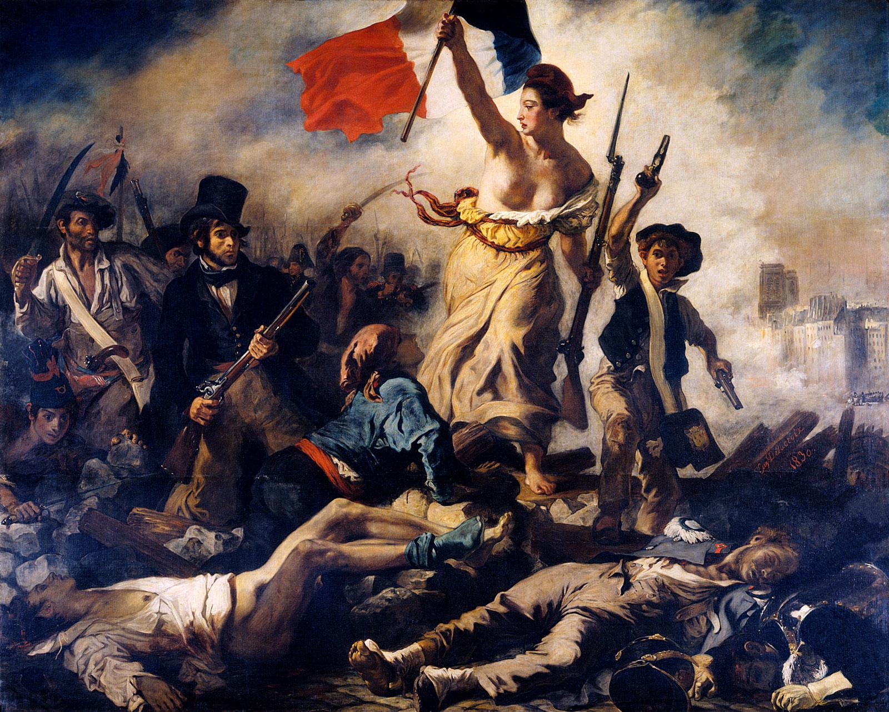
What artistic style is this?
Romanticism
Realism
Impressionism
Post-Impressionism
Modernism

Slide 18
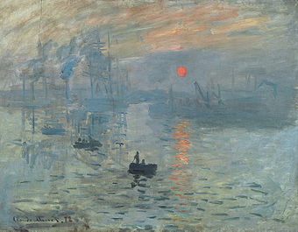
What artistic style is this?
Romanticism
Realism
Impressionism
Post-Impressionism
Modernism

Slide 19
Thanks For Listening and Participating

