Slide 1
FOOD IN THE
USA

Slide 2
Myths About American Food
Americans only eat unhealthy food
This is a common stereotype
All Americans eat McDonalds and Burger King
I have had Burger King two times in my life
America has its own cuisine
America does not have just one cuisine. American cuisine is a combination of food from all over the world and varies throughout the country. The most popular foods are different in every state.
Example: New York has the best bagels and pizza, the South has the best fried chicken and biscuits

Slide 3
Facts About American Food
Healthy food is much more expensive than unhealthy food
Americans are busy and often eat “on-the-go”
Some Americans eat extremely healthy
Many people are vegan or vegetarian
When Americans have the time and money they choose to eat healthy
Fruits and Vegetables in America last longer because of all the pesticides used

Slide 4
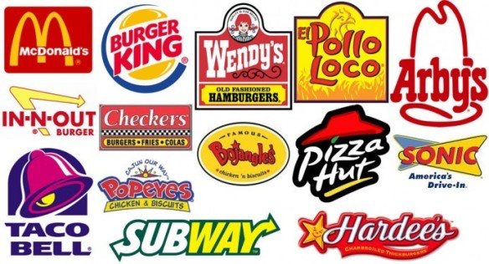
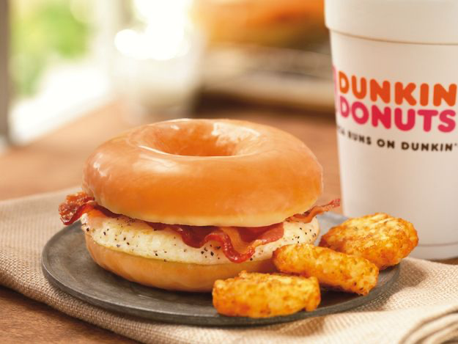
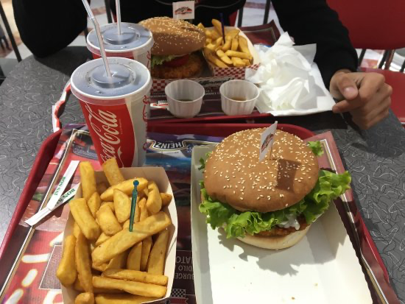
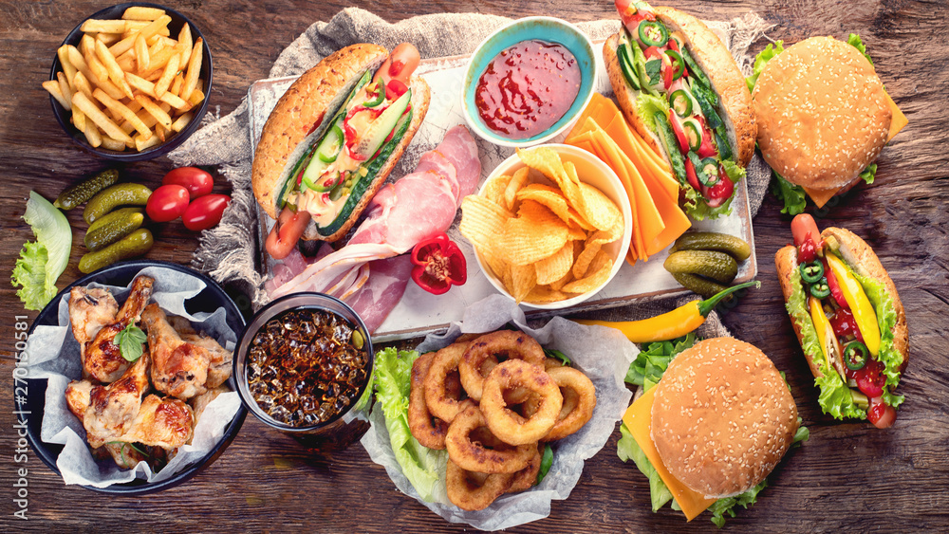
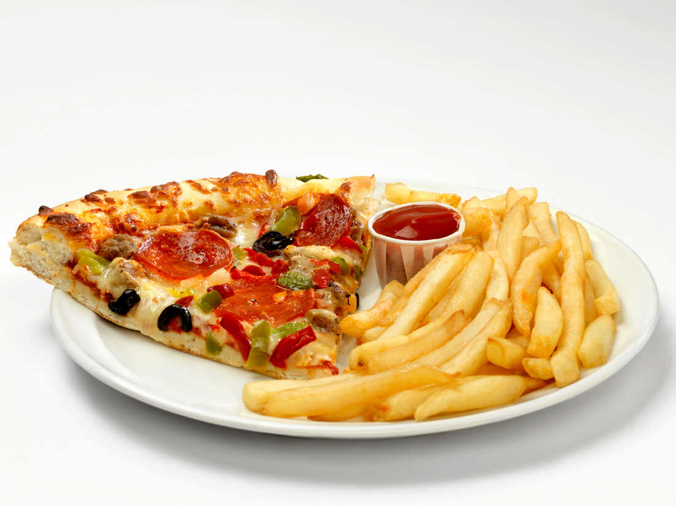
What Most People Think Americans Eat

Slide 5
Breakfast
Monday to Friday most Americans eat breakfast between 7:00 and 8:30 before they go to work or school
This meal is usually something quick to make
On Saturdays and Sundays most Americans sleep longer and eat between 9:00 and 11:00
This meal is usually bigger and takes longer to make

Slide 6
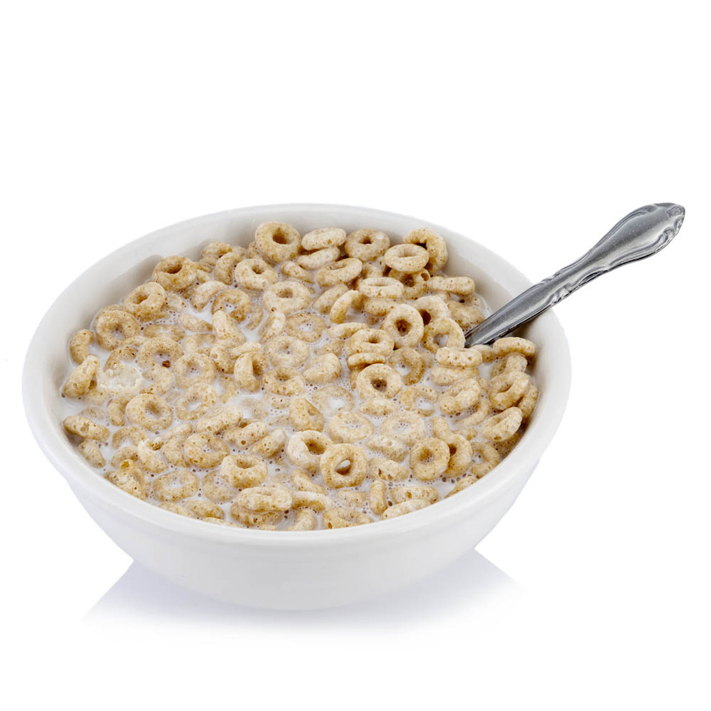
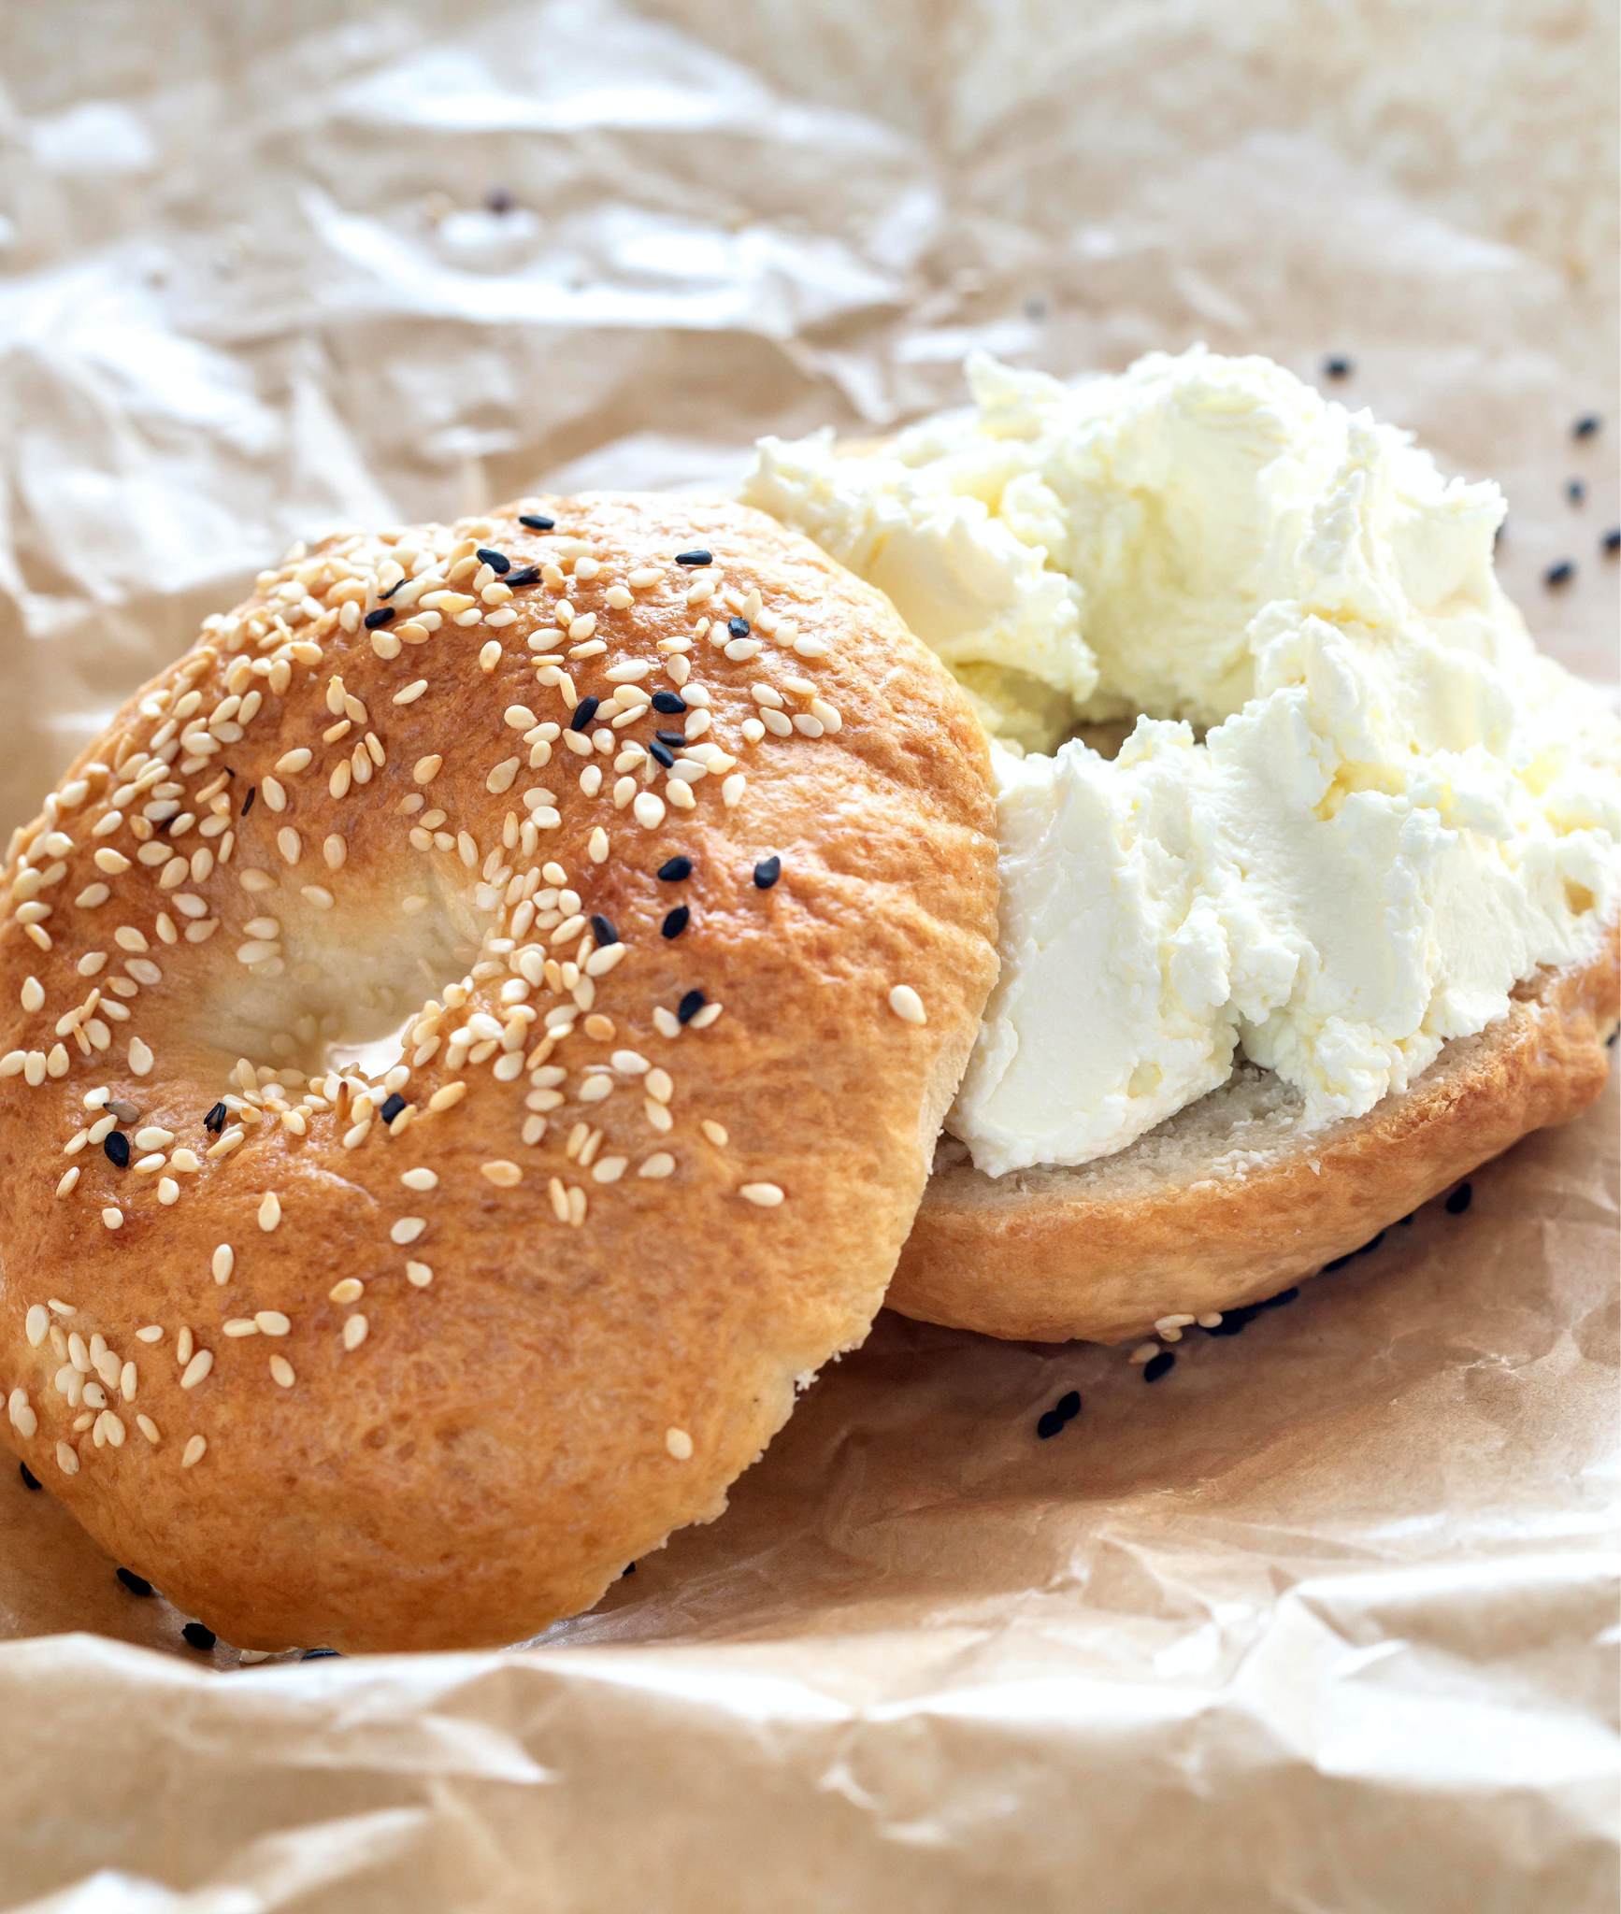
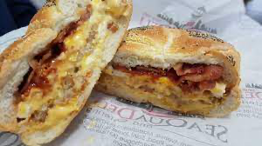
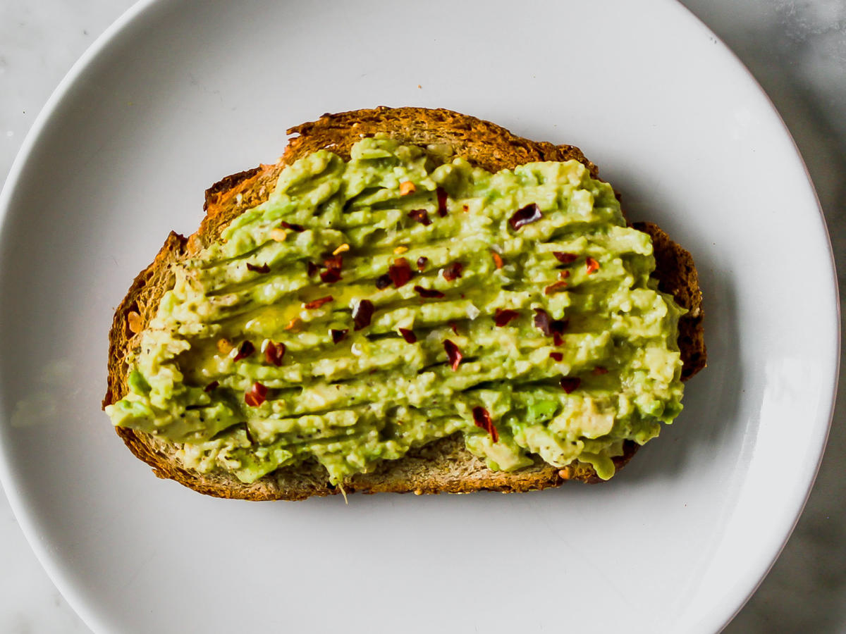
Typical Monday to Friday Breakfast Foods

Slide 7
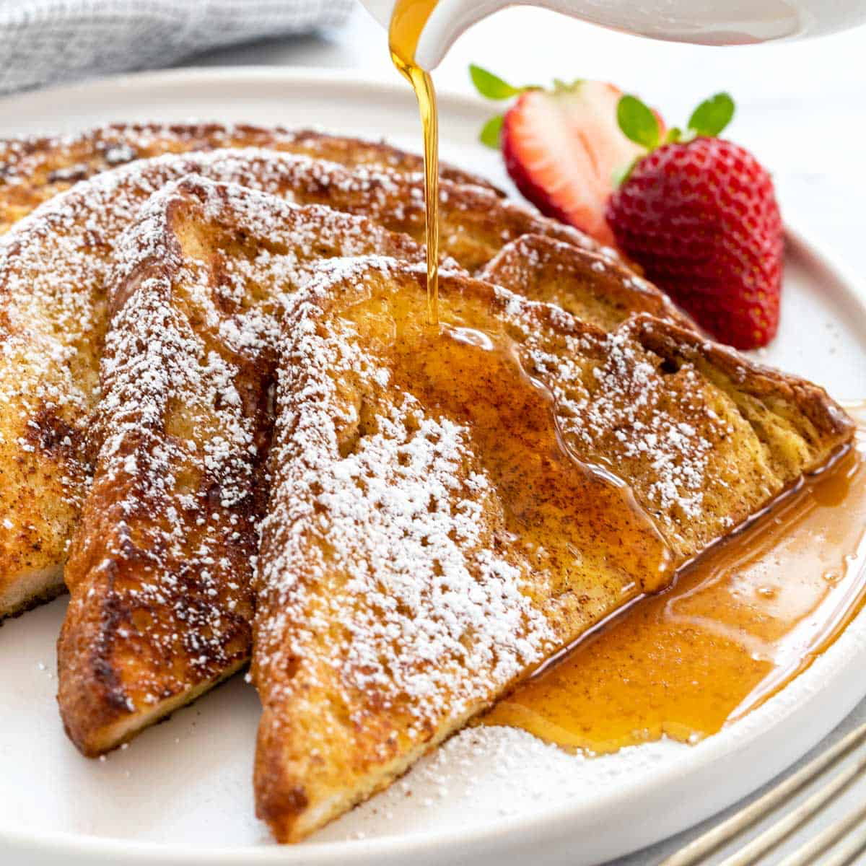
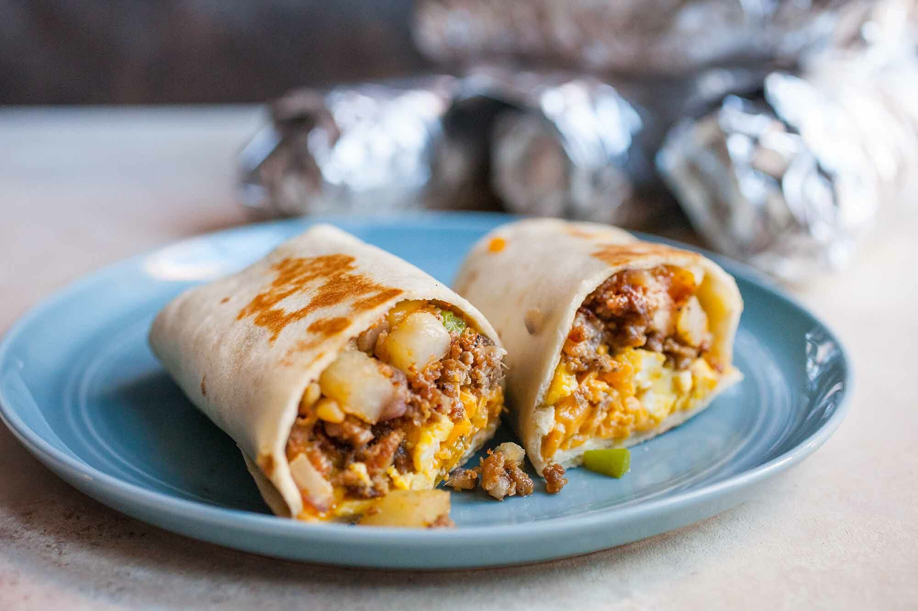
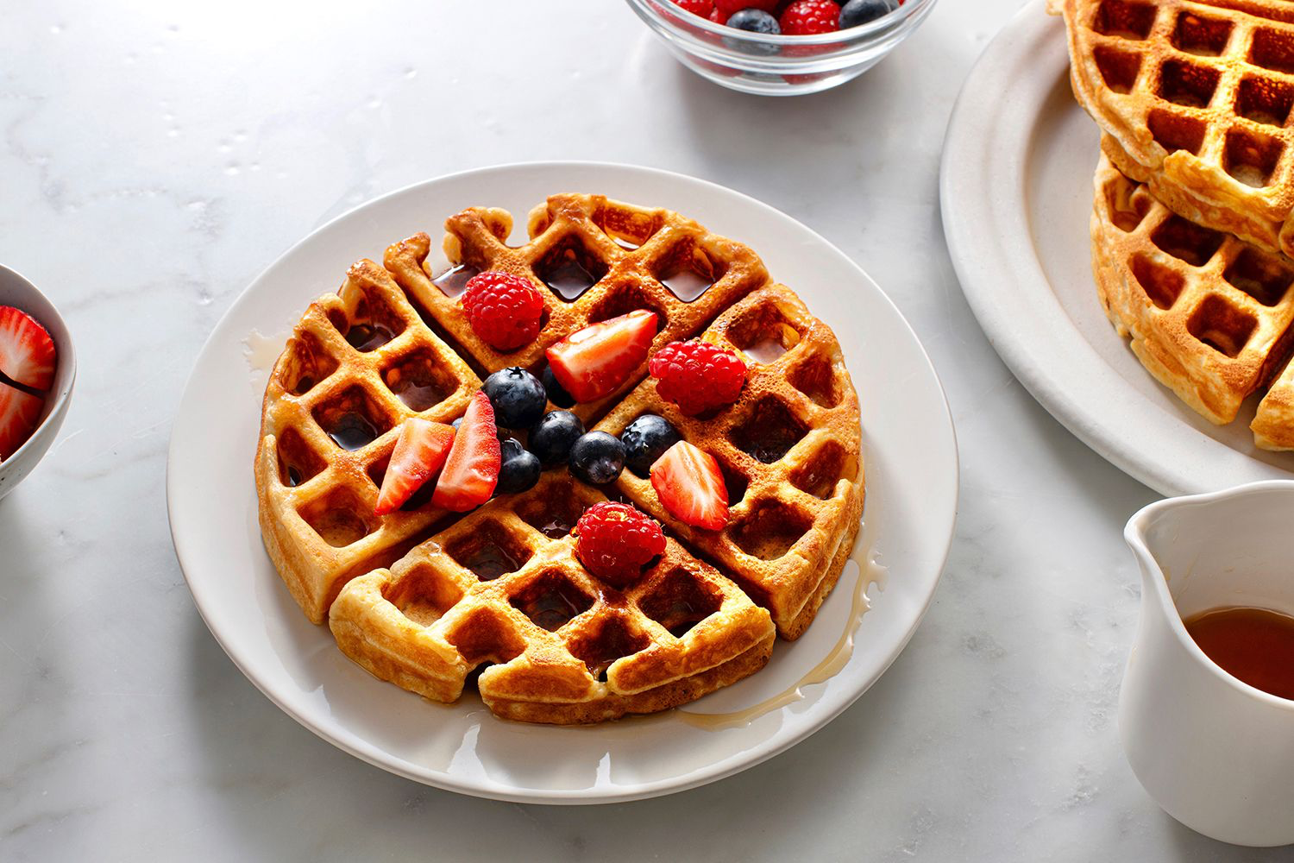
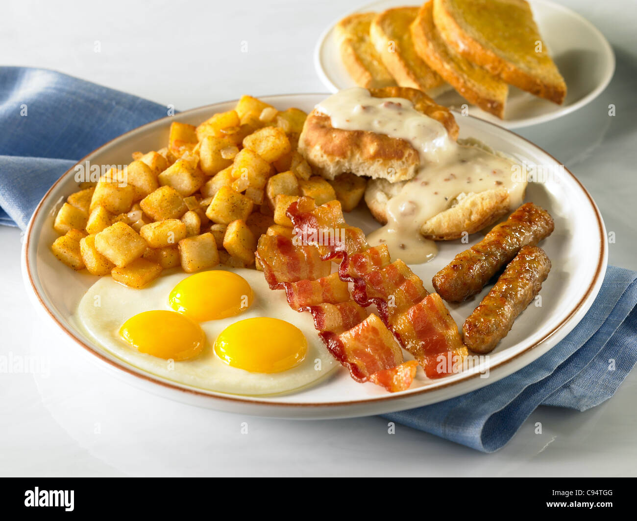
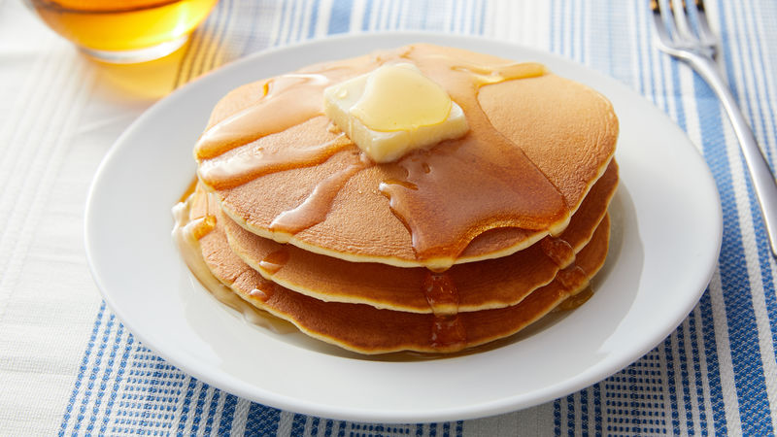
Typical Saturday and Sunday Breakfast Foods

Slide 8
Lunch
Most Americans eat lunch between noon (12:00) and 2:00pm (14:00)
Many Americans buy their lunch at work or at school, but some people make their own

Slide 9
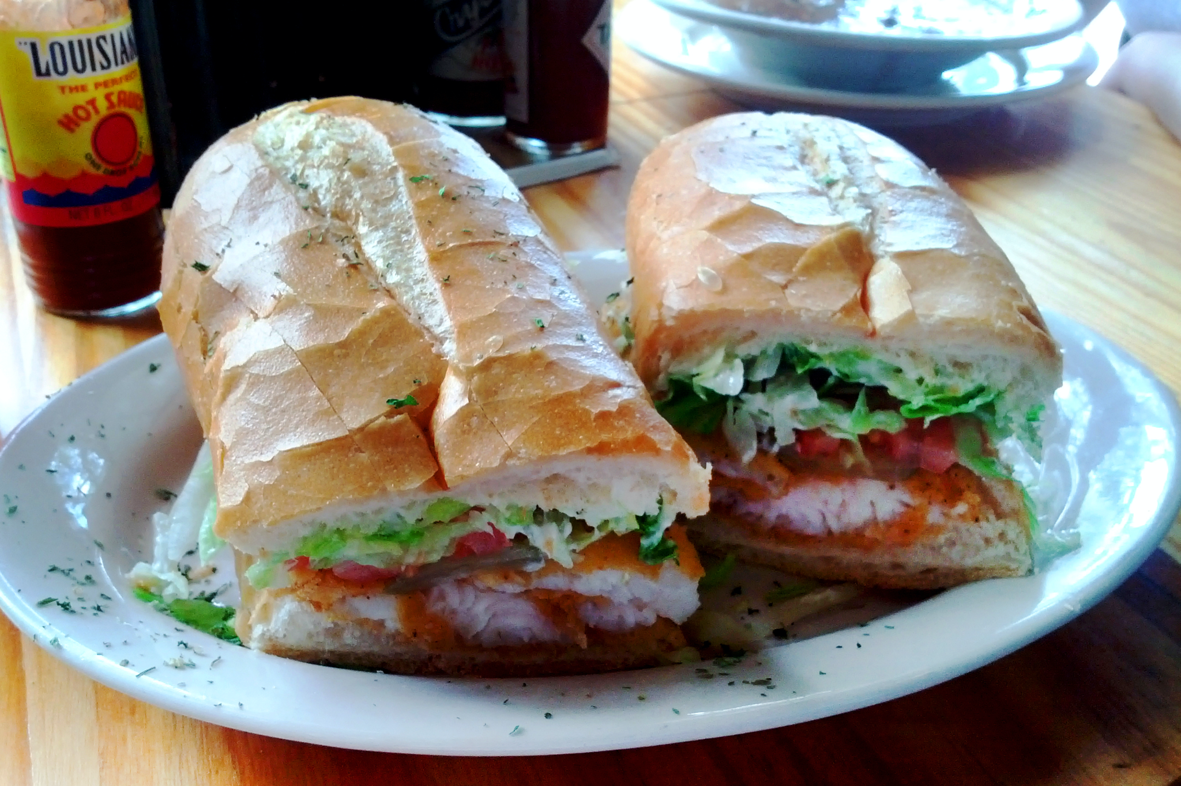
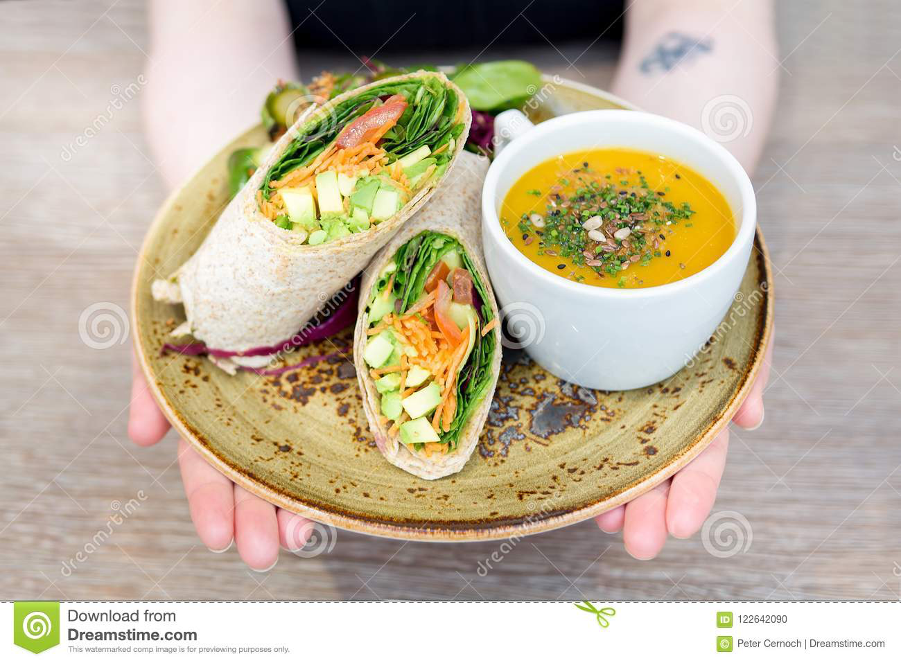
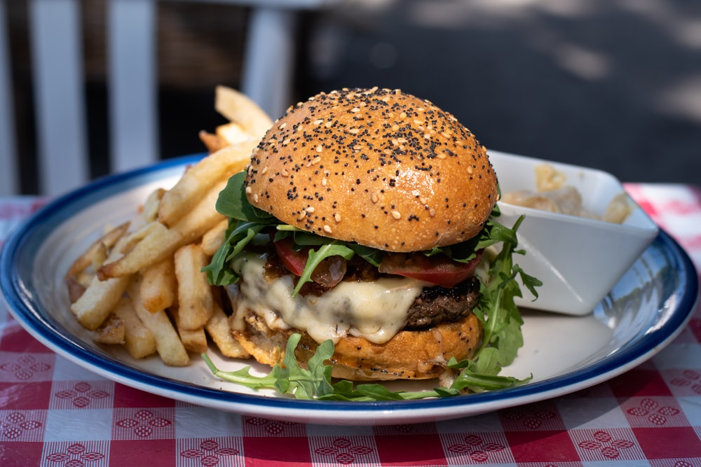
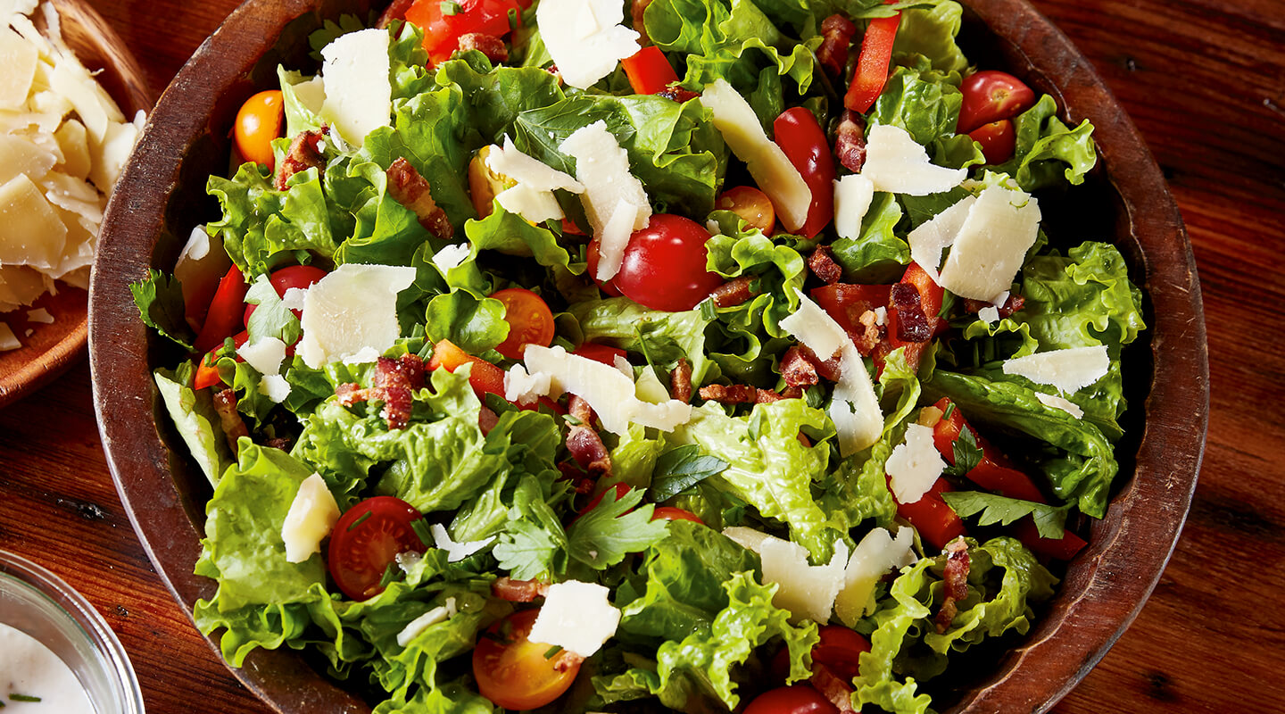
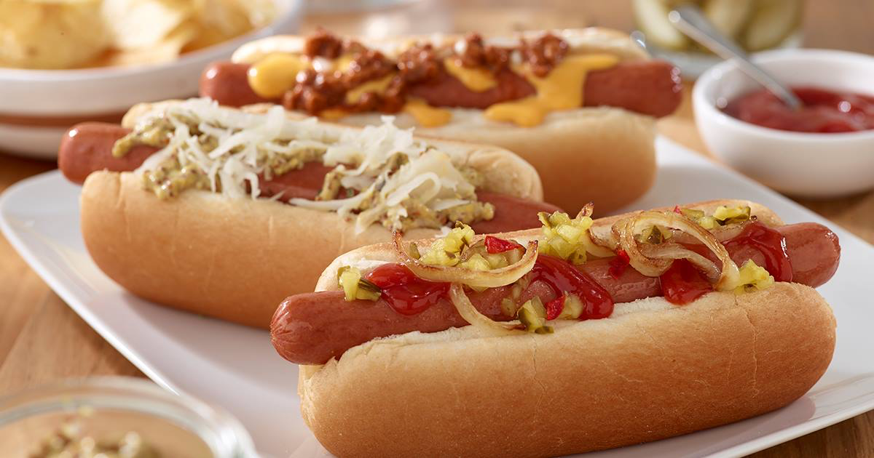
Typical Lunch Foods

Slide 10
Dinner
Most Americans eat dinner between 5:00pm (17:00) and 9:00pm (21:00)
Many families sit down and eat together after cooking a large meal

Slide 11
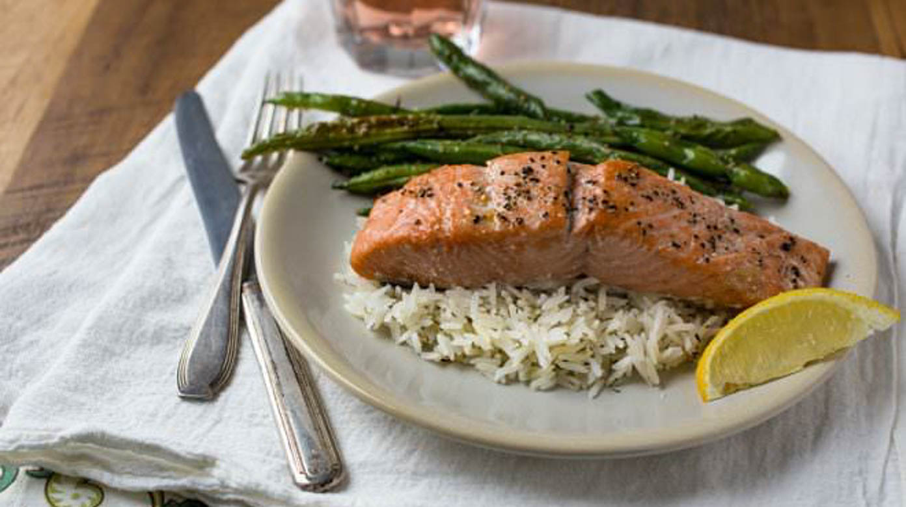
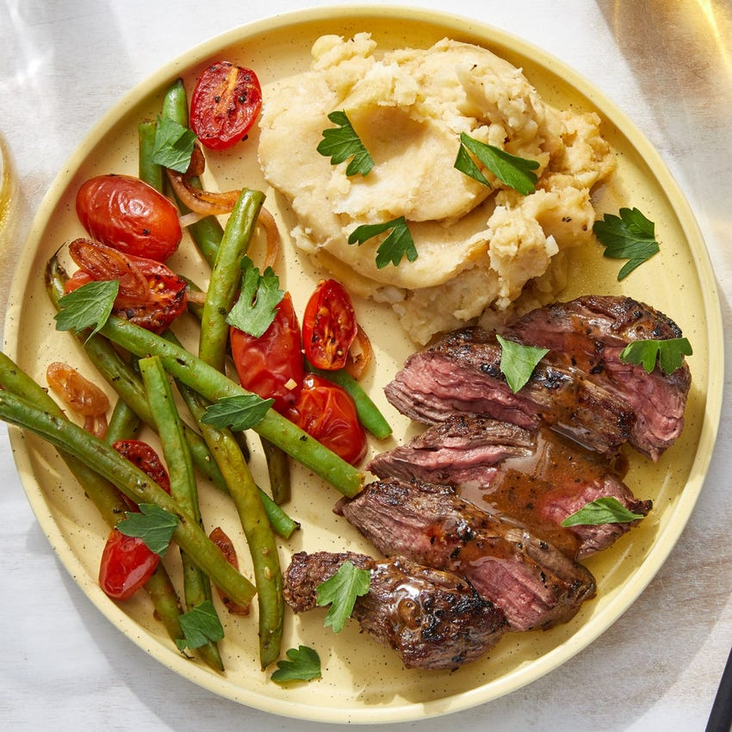
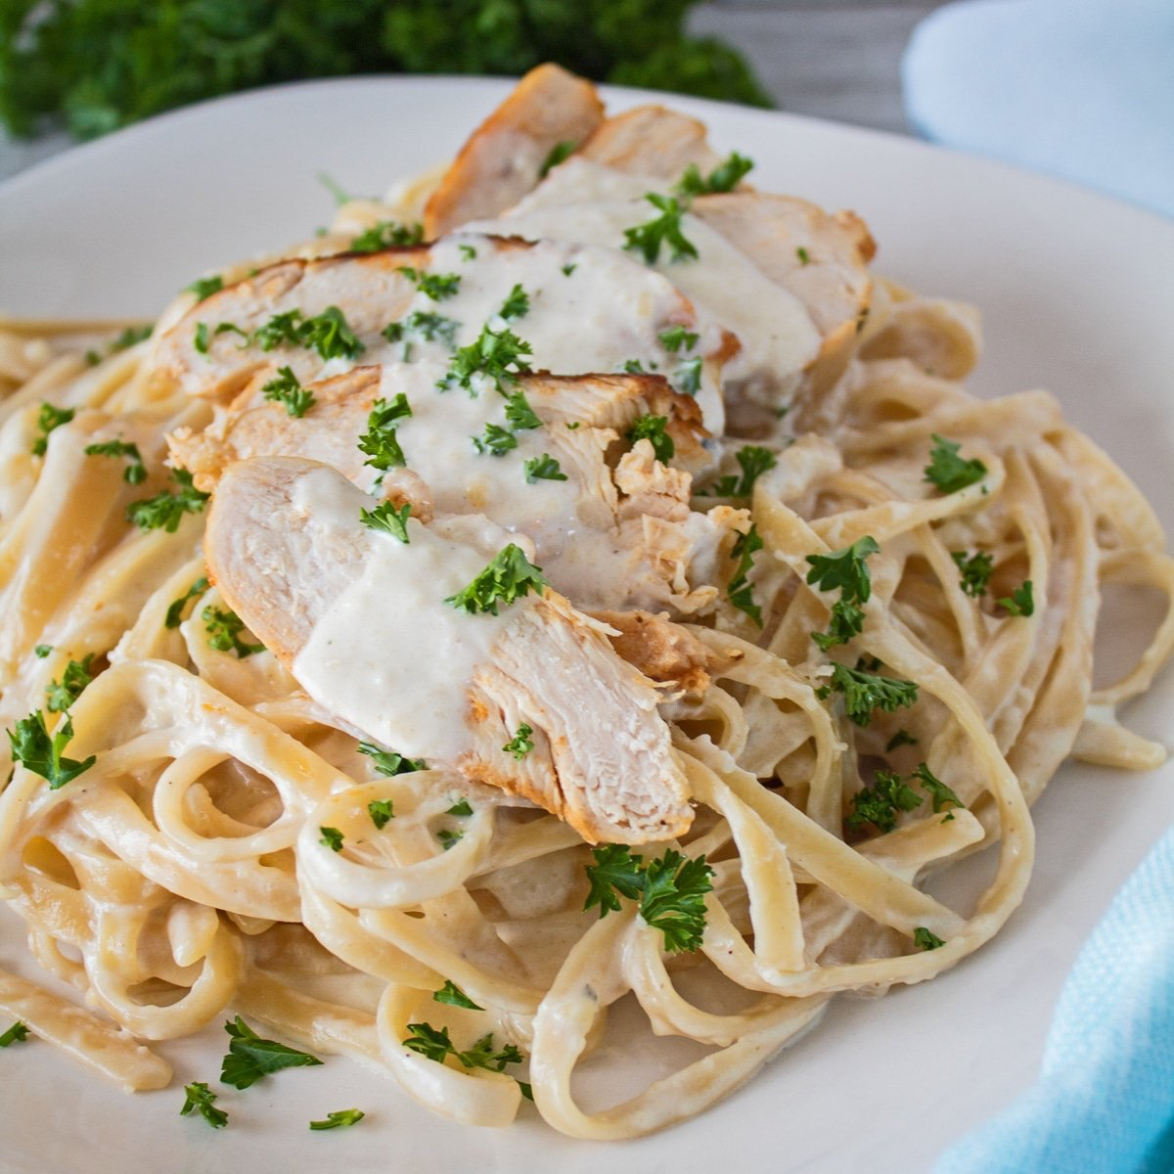
Typical Dinner Foods

