Slide 1
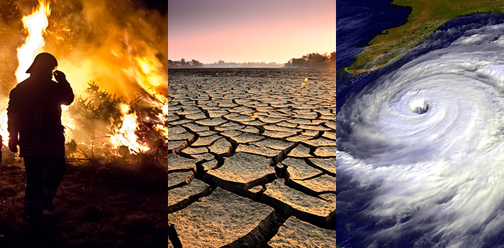
Climate Change

Slide 2
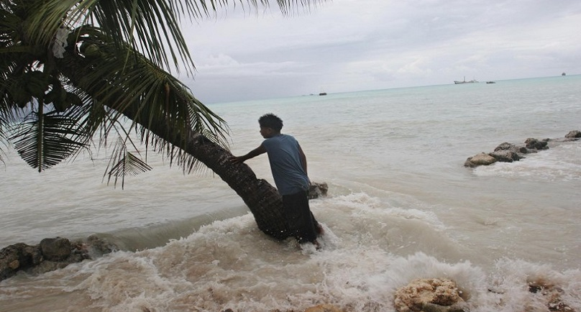

Slide 3
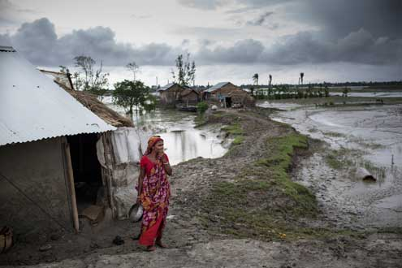

Slide 4
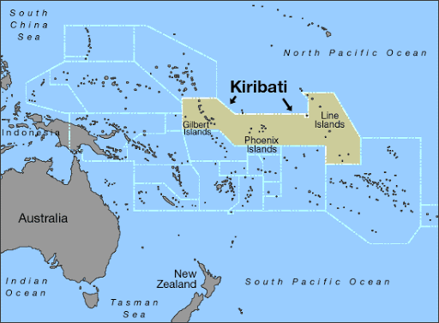
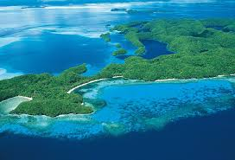
Kiribati
An island republic, in the Central Pacific Ocean, approximately 8,000km east of Australia.

Slide 5
Pre-Video Task
Look at the expressions and words in the table below. Use as many of the words and expressions to write a paragraph summarising what you think the video will be about.
Scientific research | High tide waves
Climate change | Moving to a new house every three years
Houses disappeared | To leave where you come from
4 metres high | Under water
Extremely vulnerable | Victims
Relocating the population | Maintain identity and the culture
Refugees

Slide 6
Link to the video: https://www.youtube.com/watch?v=cIG7vt1ZPKE
Watch the video about Kiribati and check to see how similar your predictions are to the actual video.
Tick the expressions from the table as you hear them.

Slide 7
1. According to scientific research, the Pacific is the region most affected by… A: climate change B: pollution C: rising sea levels
2. Kiribati is… A: lower than 4 metres above sea level B: a maximum of 4 metres above sea level at the highest point C: only 4 metres from the sea
3. The projections from scientists make the president of Kiribati feel… A: pessimistic about the future B: optimistic about the future C: realistic about the future
4. According the president of Kiribati, becoming a refugee is caused… A: by events happening that are expected B: by events that we can plan for C: by events that haven’t been planned for
5. Tangaroa says that older people from Kiribati don’t understand the problems because… A: they believe they should stay on their land until they die B: they find it difficult to sell their property C: they have never left before

Slide 8
Discussion
The video you have watched shows how climate change and rising sea levels is affecting the islands of Kiribati and its people. Think about the following questions:
• In what way has climate change affected where you live?
• How will it affect where you live in 5,10, 20 or 50 years from now?
• What do you do to help the environment? What could you do more of/less of?
• How do you feel when you hear people say that climate change isn’t real?

Slide 9
Spend 5 minutes writing some notes about your thoughts, feelings and opinions about the questions.
When you have finished writing, discuss your notes with a partner.

Slide 10
Agree or Disagree
Agreement
Disagreement
I really think / believe so, too.
I couldn’t agree more.
You have a point there.
No doubt about it.
Partial Agreement
I agree with you up to a point…
I see what you mean, but…
I’m sorry but…
I beg to differ.
I don’t agree with you on that
That’s not necessarily true.
Partial Disagreement
You may be right, but…
That might be true, but…

Slide 11
Express Your Opinion
I/It + verb…
In/From/To my…
I think / consider / find / feel / believe / suppose / presume / assume that…
I would say that…
It goes without saying that…
It seems to me that…
In my opinion,…
In my view,…
In my eyes,…
From my point of view,…
To my mind,…
To be honest,…

