Slide 1
The Periodic Table

Slide 2
Key Points
All elements are arranged in a chart called the periodic table.
The arrangement of elements is based on their structure and properties.
A Russian scientist named Dmitri Mendeleev produced one of the first practical periodic tables in the 19th century.

Slide 3
The development of the periodic table
In the 1800s, scientists had discovered many new , but no system existed to organise them. Scientists were trying to look for similarities in their properties to arrange them in a meaningful way.
Early attempts to organise the elements
John Newlands noticed that if the elements were ordered by , every eighth element had similar properties. For example, sodium is the eight places further on than lithium and reacts in a very similar way.

Slide 4
Organising the elements
For example, lithium (Li), sodium (Na) and potassium (K) all have the same kind of reaction with water
Li | Lithium
Na | Sodium
K | Potassium
Julius Meyer arranged elements by atomic weight and by the number of the element usually combined with.

Slide 5
O | Oxygen
S | Sulfur
Se | Selenium
Te | Tellurium
This group of elements were grouped together because they tended to combine with two other atoms. For example, one oxygen atom combines with two hydrogen atoms to make water (H₂O)

Slide 6
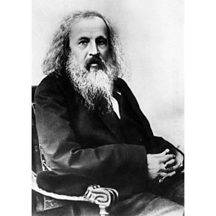
Mendeleev’s periodic table
A Russian scientist called Dmitri Mendeleev produced one of the first practical periodic tables in the 19th century.
The modern periodic table is based closely on the ideas he used.
These ideas were:
The elements are arranged in order of increasing atomic number
The horizontal rows are called periods
The vertical columns are called groups
Elements in the same group are similar to each other

Slide 7
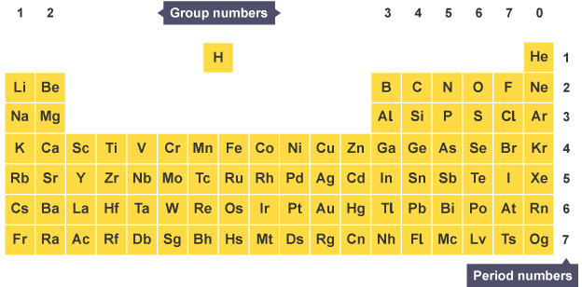
Mendeleev’s periodic table

Slide 8
How did Mendeleev produce the periodic table?
Mendeleev wrote the names of elements onto cards to help him look for patterns. He put the cards in order of lightest to the heaviest element and made groups based on the and of each element.
Mendeleev recognised that not all elements had been discovered yet. He left gaps in his table to place elements that scientists didn't yet know.
By looking at the physical properties and chemical properties of elements next to gaps, he could even predict the properties of these undiscovered elements.

Slide 9
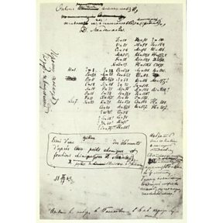
Mendeleev's original periodic table showing the gaps he left for elements to be discovered

Slide 10
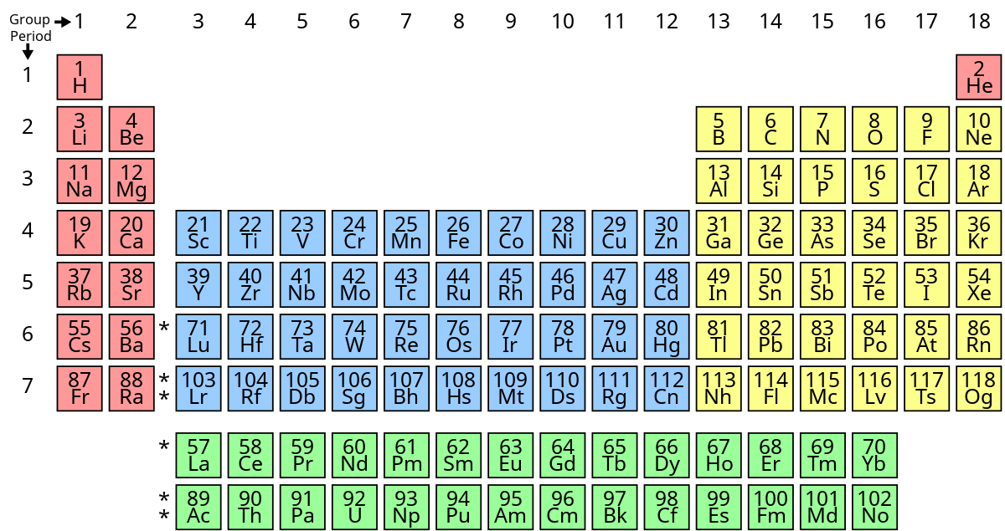
Did you know?
Mendeleev’s work is the basis of the modern periodic table we use today.
He is often referred to as the 'father of the periodic table', but he didn’t achieve a Nobel Prize for his work
This Photo by Unknown Author is licensed under CC BY-SA

Slide 11
The modern Periodic Table
The modern periodic table has no gaps and has extended beyond what Mendeleev predicted. There were 64 elements when Mendeleev was working on his table and he predicted 4 more. Now the periodic table has 118 elements
This Photo by Unknown Author is licensed under CC BY-SA

Slide 12
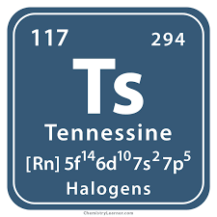
Did you know?
The most recent element to be discovered is Tennesine which was made in a laboratory in 2009.
This element only exists for fractions of a second, because it is unstable meaning it breaks apart very quickly

Slide 13
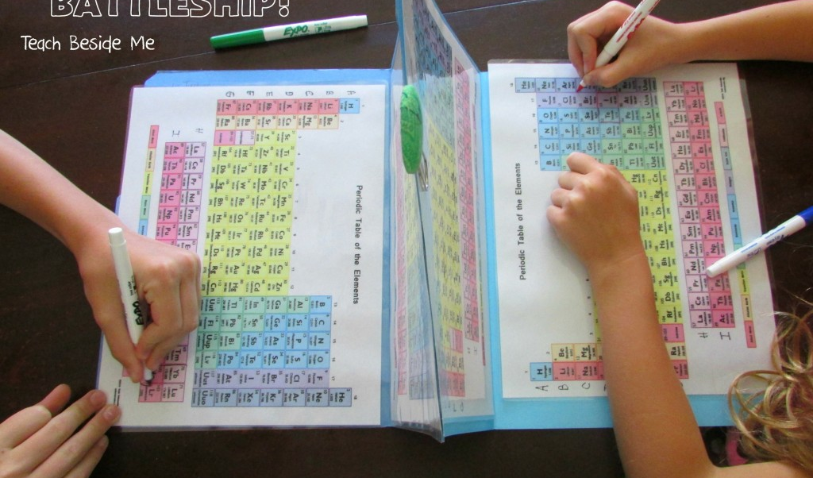
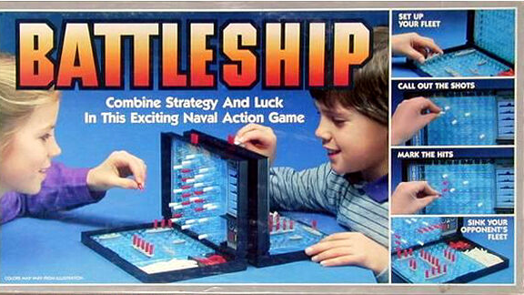
Periodic Table “Battle Ships”

Slide 14
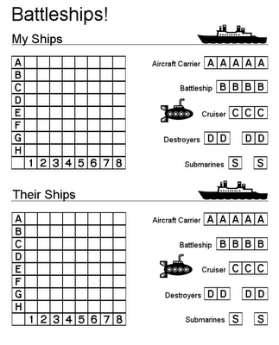
The Ships

