Slide 1
The Second Industrial Revolution and INventions
Late 19th Century

Slide 2
Introduction:
New energy sources and industries prompted a Second Industrial Revolution
Occurred in the late 19th century
Spread to Germany, the USA, and Japan

Slide 3
New Energy Sources
Electricity and Oil were the new sources
The invention of dynamo (in 1869) was the first electrical generator to give power for industrial purposes
Dynamo was the foundation electrical power
Oil was first extracted in the US in the 19th century
It was used as fuel for engines

Slide 4
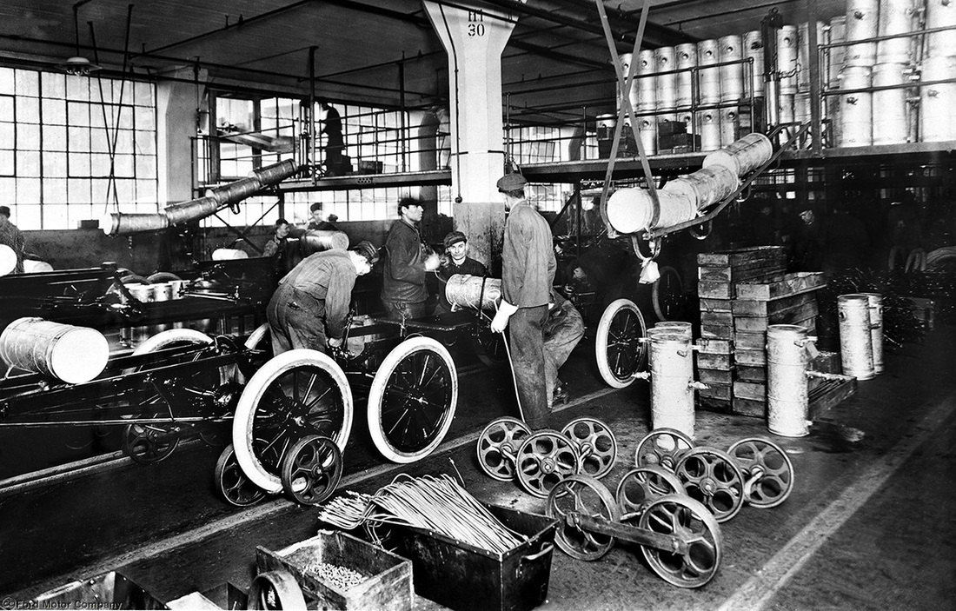
Invention of The Car
Oil had a large impact on the first cars
Karl Benz invented the modern car

Slide 5
Major Advances
Diesel engines
Made ships faster and they could travel further
New metals
Stainless steel and aluminum
Chemical industry in Germany
New fertilisers, pharmaceuticals, and other chemical products
Construction of skyscrapers
Mass production of steel and reinforced concrete

Slide 6
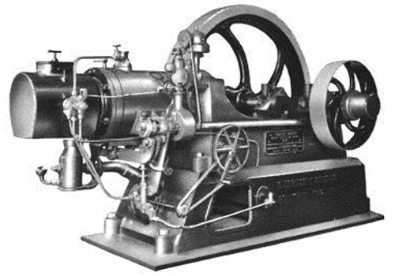
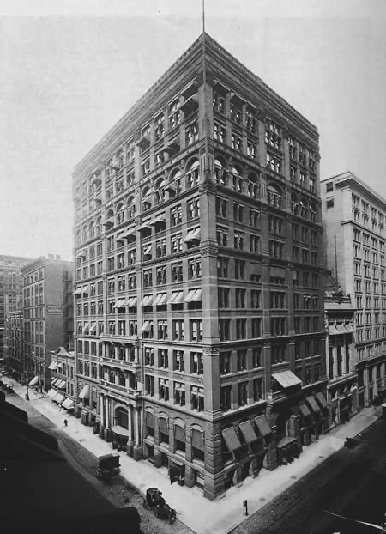
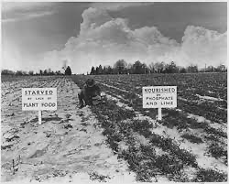
Vocab
Diesel engines
Chemical industry in Germany
New fertilisers, pharmaceuticals, and other chemical products
Construction of skyscrapers

Slide 7
The Creation of Mass Production
People wanted to increase production and reduce costs
Factories produced on a biggers scale (made more things at one time)
This led to Taylorism

Slide 8
Taylorism
Helped with the production line in factories
It divided production into jobs with specific machines and workers for each step
This system originated in the United States
One of the first items to use this method was Ford cars

Slide 9
Fordism
The mass production of cars
This made it less expensive and more people could afford to buy cars
Workers’ salaries were increased
This encouraged more people to buy cars and the market to grow

Slide 10
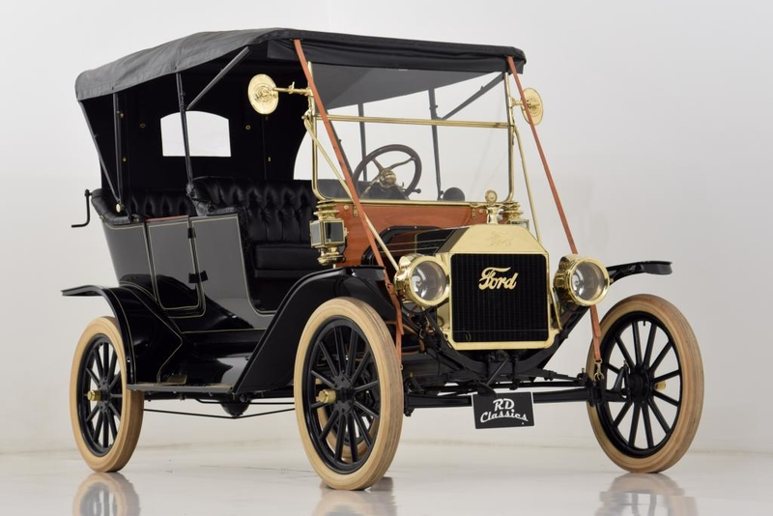
The First Ford
Manufactured in 1912 and was called the Ford model T

Slide 11
Industrial Concentration
The ability to manufacture at low costs led to the desire to suppress competition
This included pools, trusts, holding companies, and monopolies

Slide 12
Vocab
Pools = agreements between companies
Trusts = merging of companies
Holding companies = financial groups formed by companies and banks
Monopolies = the exclusive right of a company to market a product (there is only one company that can sell the product)

Slide 13
Timeline of New Inventions

Slide 14
Matching
The exclusive right of a company to market a product
Merging of companies
Agreements between companies
Financial groups formed by companies and banks
Pools
Trusts
Holding companies
Monopolies

Slide 15
Questions
What country do you think had the most industrial growth?
What were some of the new energy sources in this industrial revolution?
Which of these is not a metal?
Aluminum
Concrete
Stainless Steel
What is a Ford?

Slide 16
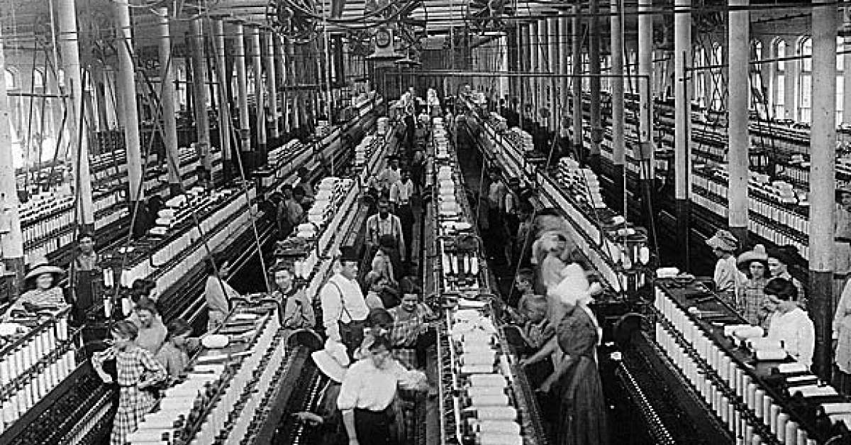
Can someone describe this Picture?

Slide 17
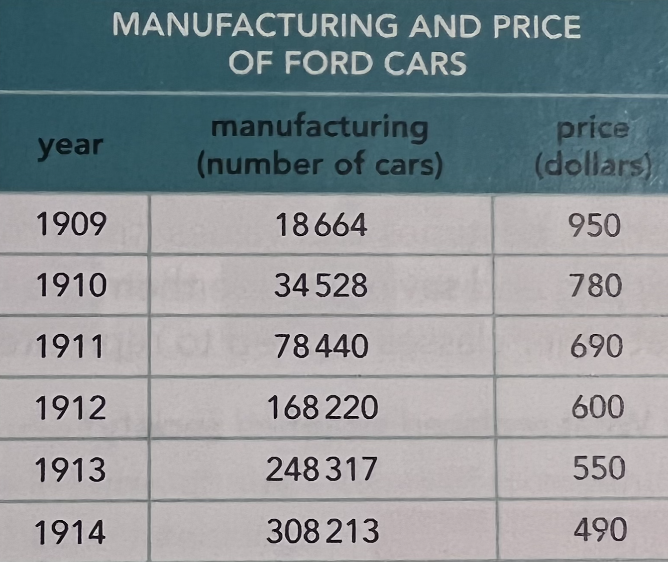
Can someone describe what is happening in this table?

Slide 18
Fun Question!
If you could invent anything, what would it be?

